Slide 1

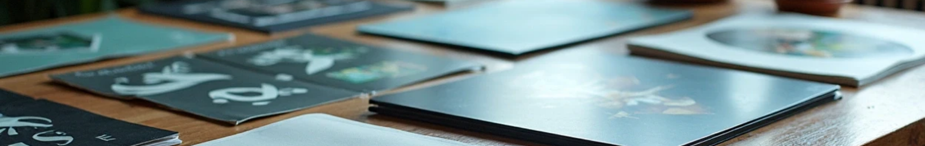

My Portfolio
Author: Rahul M
Created with Pi

Slide 2

CONTENTS
1. Home
2. About Me
3. Education
4. Skills
5. Projects
6. Experience
7. Certificates / Achievements
8. Contact
9. Footer

Slide 3


01
Home

Slide 4
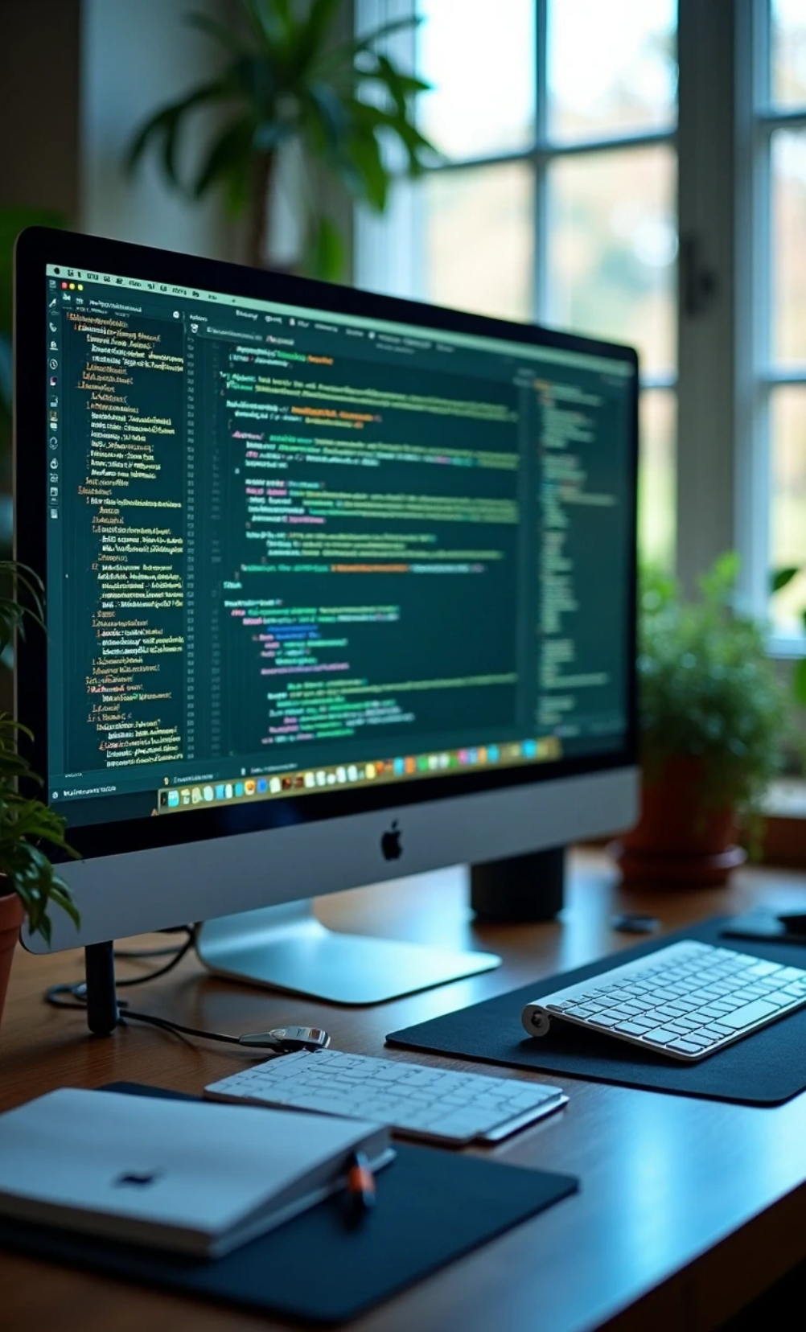


Home
Introduction
• Web Developer | Designer | Programmer
Navigation
• About
• Education
• Skills
• Projects
• Experience
• Certificates
• Contact

Slide 5

02
About Me

Slide 6

Introduction
Hello! I am Rahul, a passionate web developer with interest in building modern, responsive and user-friendly websites and applications.

Slide 7

03
Education

Slide 8
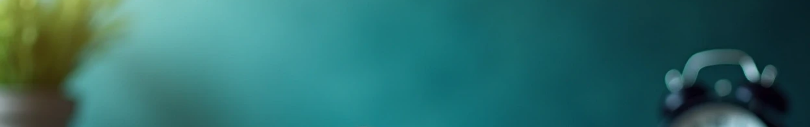

Academic Background
B.Sc Computer Science: GASC College (2024 - 2027)
HSC: ABC Higher Secondary School (2023 - 2024)
SSLC: ABC Higher Secondary School (2022)

Slide 9
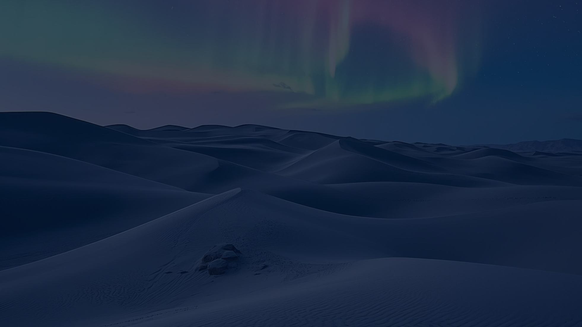
04
Skills

Slide 10
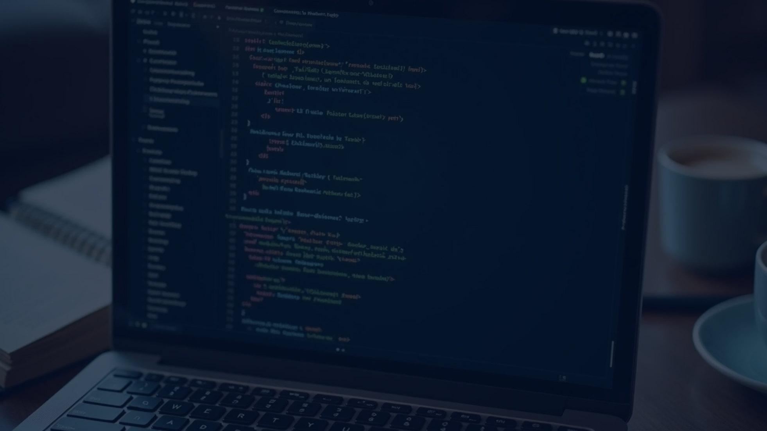

Technical Skills
HTML, CSS, JavaScript
React & Node.js
Python, C, Java
Database: MySQL, MongoDB
UI/UX Design

Slide 11

05
Projects

Slide 12
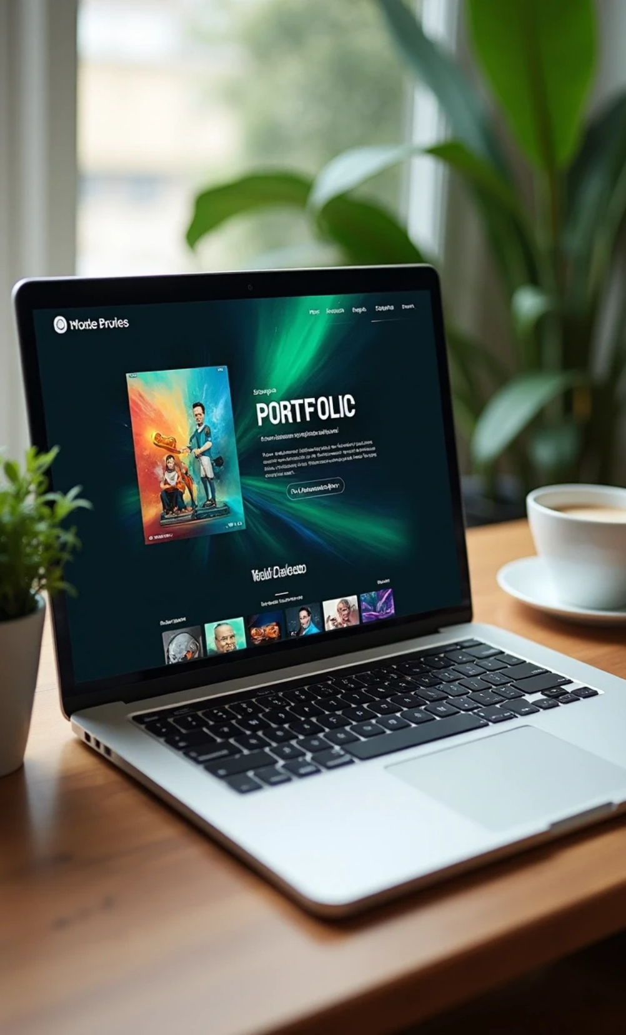
Project Overview
Portfolio Website
A responsive personal portfolio site.
Todo App
A task manager with add/edit/delete features.
Calculator
Simple web-based calculator using JavaScript.

Slide 13
06
Experience

Slide 14
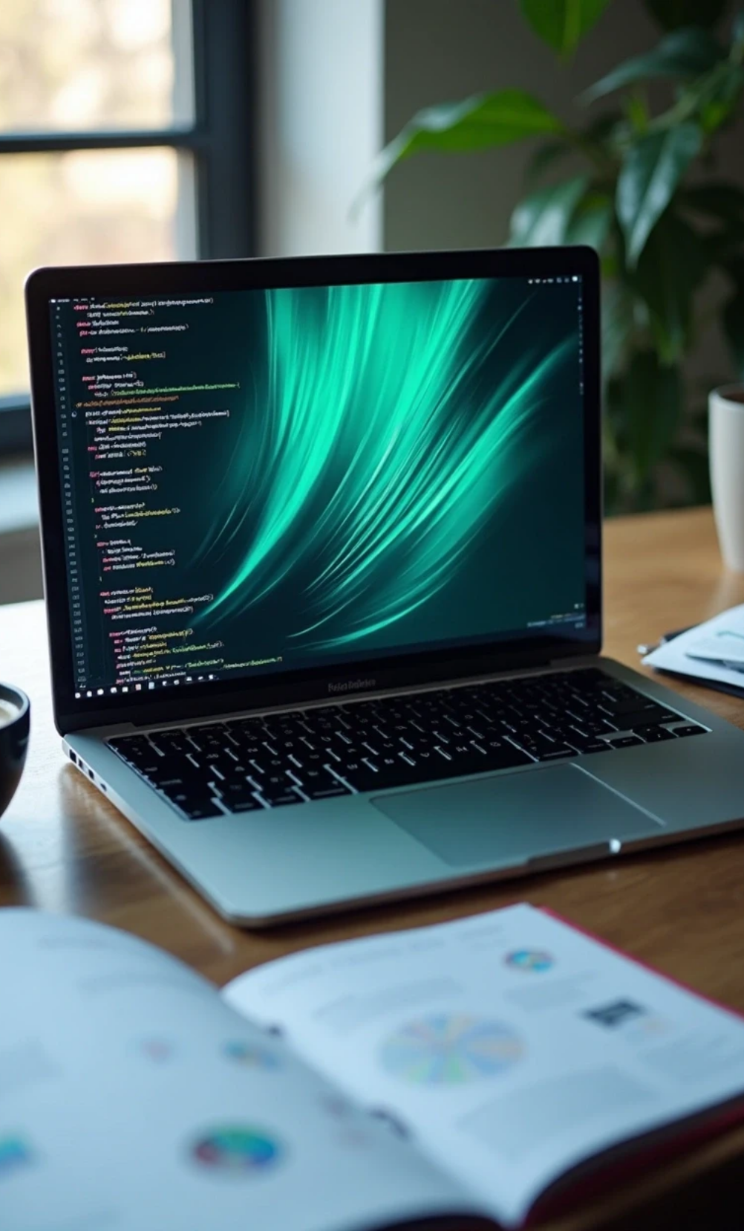

Internship Experience
Internship – Web Developer: at XYZ Tech (2027)
• Worked on front-end design, responsive UI, and API integration.

Slide 15
07
Certificates / Achievements

Slide 16
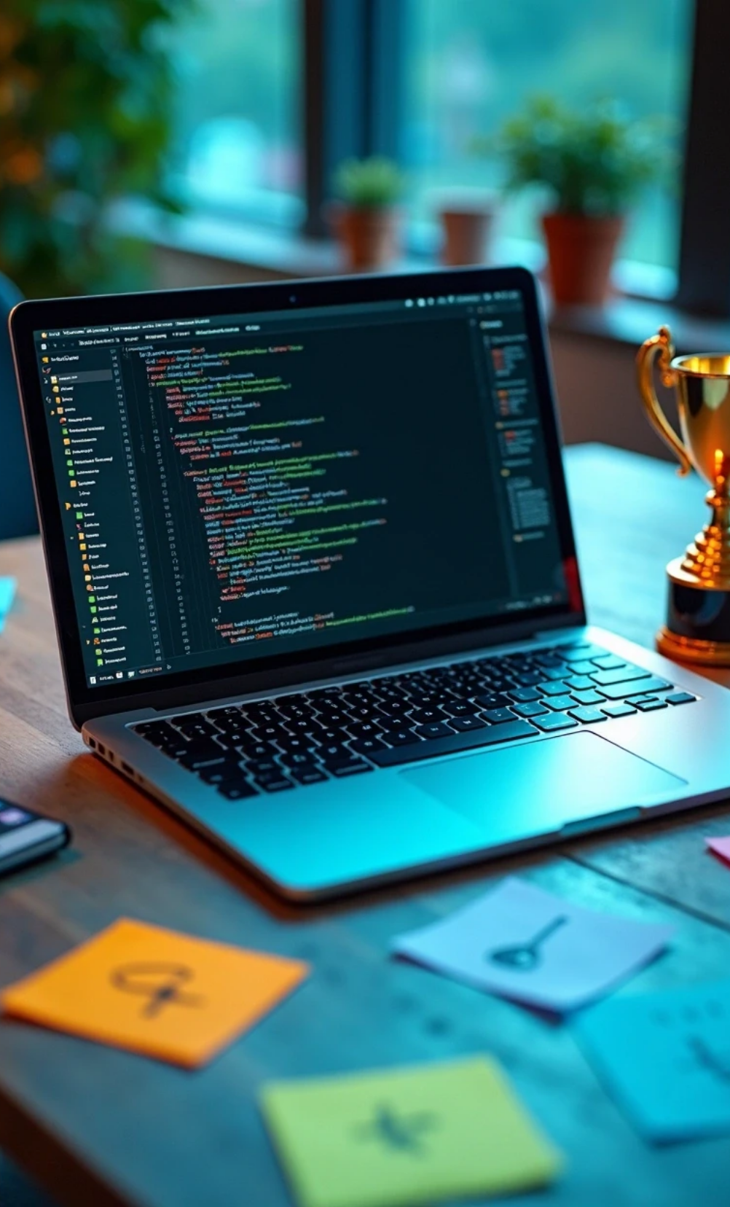
Certifications
Full Stack Development: Coursera
Python Programming: HackerRank
Web Design Competition: 1st Prize

Slide 17
08
Contact

Slide 18
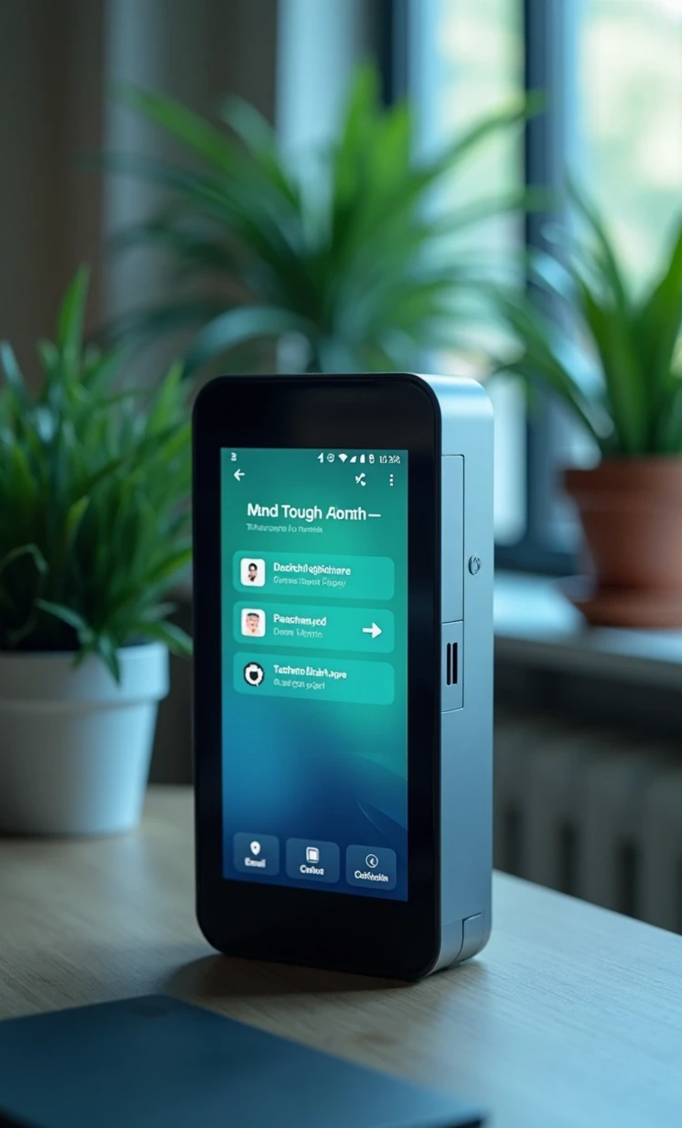

Contact Information
Email
Phone
rahul@example.com
+91 9876543210
GitHub
LinkedIn
github.com/rahul
linkedin.com/in/rahul

Slide 19
09
Footer

Slide 20

Acknowledgment
© 2025 Rahul. All Rights Reserved. | Designed with ❤️

Slide 21
Thank You

